Slide 1

American International University - Bangladesh
Name ID
Baki, Md. Abdullah Al 14-27968-3
Shihab, Mehedi Hasan 14-27923-3
Rashid, Md. Mamun Or 15-28965-1
Submitted to:
MOHAMMAD MAHMUDUL HASAN

Slide 2
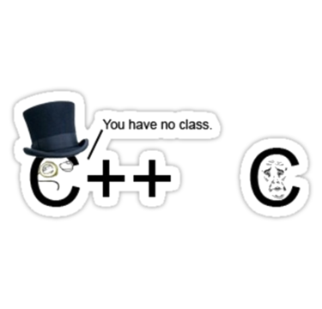
Programming Language-2 project
AIUB Grading System

Slide 3
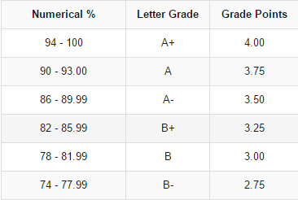
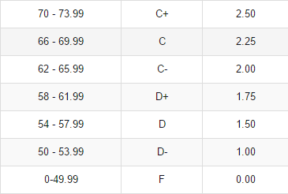
Important information of the project:
•Grading System

Slide 4
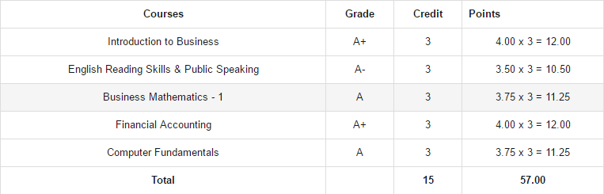
Computation Of CGPA

Slide 5
Mark distribution
For theory:
Three quizzes(best two) 20 x 2 = 40
Performance 10
Attendance 10
Term exam ________40_____
Total= 100
For Lab:
Lab report 5 x 10 = 50
Performance 10
Attendance 10
Lab quize ________30_____
Total= 100

Slide 6
Component of the C++ project
Class
Object
Inheritance
Function
Operator
Exception Handling

Slide 7
Class
We declared and used two classes in our C++ project named “grade” and “calculation”. In the grade class we declared protected variables and they are q1,q2 & q3. Then in the public section we declared a function named “setq()” for setting the values of q1,q2 & q3. In public we also declared three variables per ,att ,term for set the values of performance ,attendance and term exam mark. We used the q1,q2 and q3 variables for setting the values of three quizes.
In the calculation class we did our all types of calculation by using functions.

Slide 8
Object
As we used two classes in our program, we declared two object to point the individual variables and function of those two classes.

Slide 9
Inheritance
Inheritance is one of the significant part of our project. We declared several functions in the Calculation class and we used them in the main function. For using the quizzes mark we inherited the setq() function by the object of calculation class. Thus we used the protected member of base class.

Slide 10
Functions & operators
In the calculation class we declared a few functions and each function did an individual calculation of this project in the main function.
In main function we used some binary operator.

Slide 11
Exception Handling
In the main function we used the exception handling in some cases. Compiler will replay if we input a wrong statement or information. Thus we could be noticed about our wrong input and immediately we can correct it easily.

Slide 12
THANK YOU

